Slide 1

Gantt’s chart

Slide 2
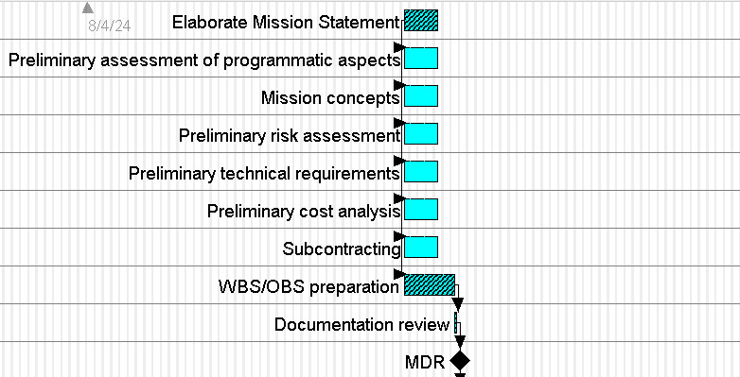
Phase 0

Slide 3
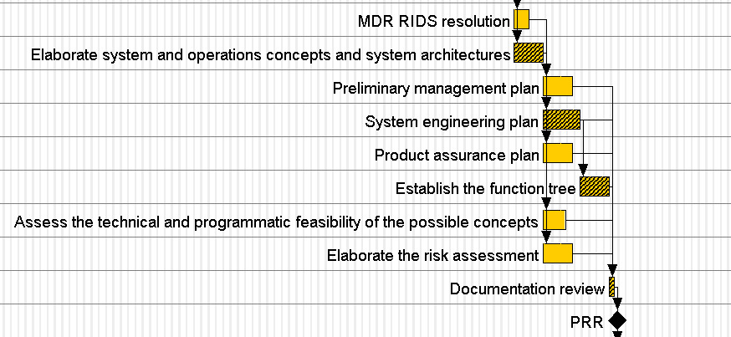
Phase A

Slide 4
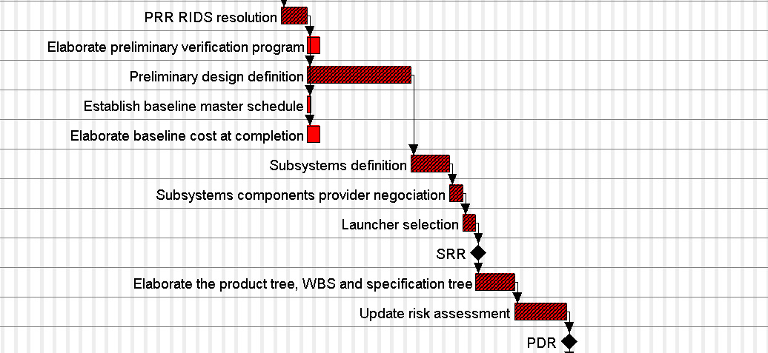
Phase B

Slide 5
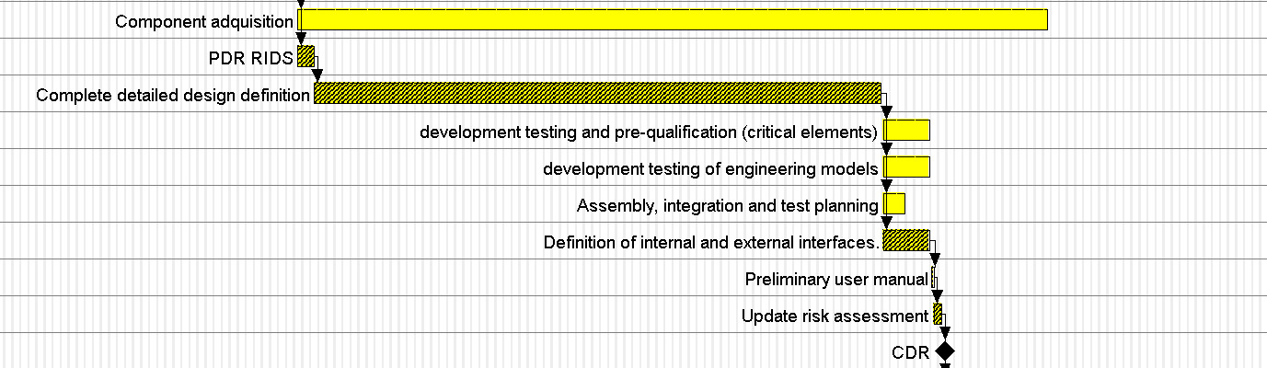
Phase C

Slide 6
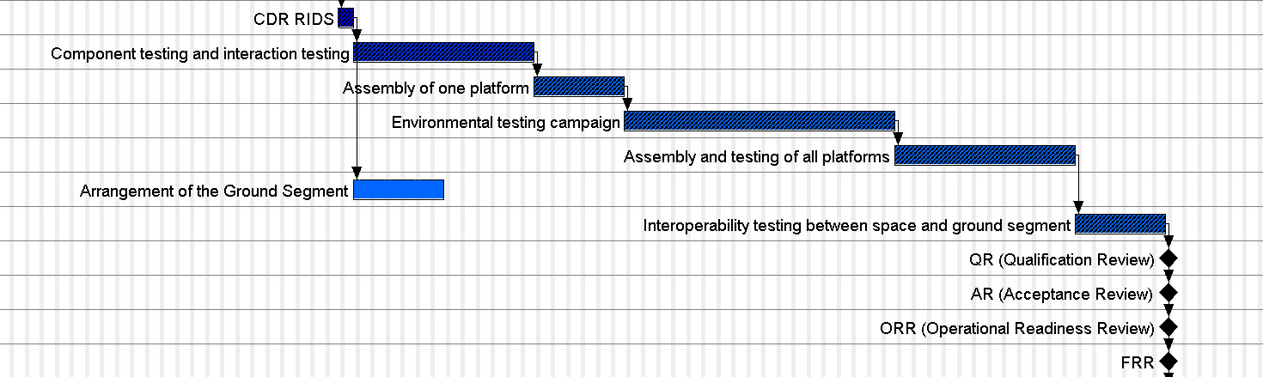
Phase D

Slide 7
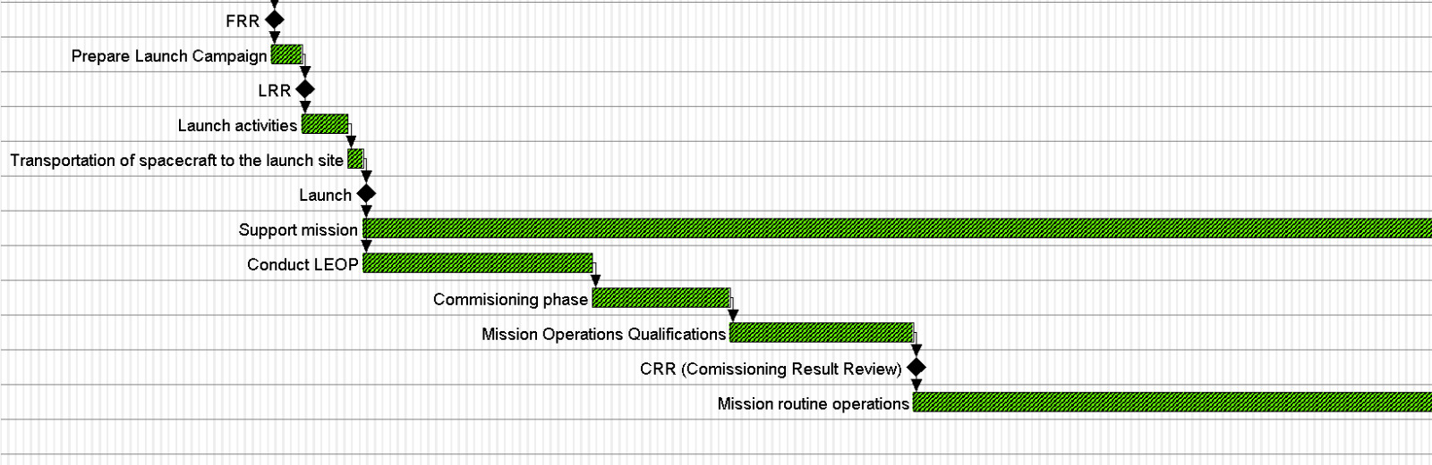
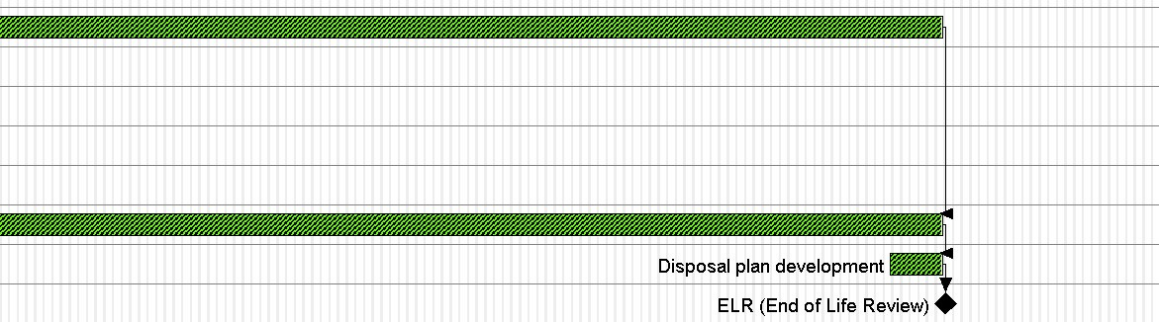
Phase E

Slide 8
WBS

Slide 9
Atlantis 2025
Management
WP - 0
Space Segment
WP - 1
Ground Segment
WP - 2
AIT Facilities
WP - 3
Launch
WP - 4
Management
Engineering
Product assurance
Notes:
Components production no se pone porque son COTS

Slide 10
Management
WP – 0
Planning
WP – 0.1
Risk analysis
WP- 0.2
Cost analysis
WP-0.3
Negotiation and contract signing
WP-0.4
Contractor supervisor
WP-0.5
Documentation and reviews
WP-0.6
Management
Engineering
Product assurance
Notes:
Components production no se pone porque son COTS

Slide 11
Management
Engineering
Product assurance
Space Segment
WP - 1
Platform
WP - 1.1
Payload
WP - 1.2
Notes:
Components production no se pone porque son COTS

Slide 12
Platform
WP - 1.1
Structure
WP - 1.1.1
Thermal control
WP - 1.1.2
Attitude and orbit control
WP - 1.1.3
Telemetry and communication
WP - 1.1.5
Command and data handling
WP - 1.1.6
On-board power supply
WP - 1.1.4
Propulsion
WP – 1.1.1.7
Management
Engineering
Product assurance
Notes:
He quitado components production porque vamos a comprar el paquete hecho

Slide 13
Structure
WP - 1.1.1
Mass analysis
WP - 1.1.1.1
Components design
WP - 1.1.1.2
Structural análisis
WP - 1.1.1.3
Vibrations and structural test
WP -1.1.1.4
Assembly integration and verification
WP – 1.1.1.5
Documentation and reviews
WP – 1.1.1.6
Management
Engineering
Product assurance
Notes:
He quitado components production porque vamos a comprar el paquete hecho

Slide 14
Thermal control
WP - 1.1.2
Thermal analysis and simulation
WP - 1.1.2.1
System design
WP - 1.1.2.2
Functional and environmental tests
WP - 1.1.2.3
Subsystem assembly
WP - 1.1.2.4
Documentation and reviews
WP – 1.1.2.6
Assembly integration and verification
WP – 1.1.2.5
Management
Engineering
Product assurance
Notes:
Components production no se pone porque son COTS

Slide 15
Attitude and orbit control
WP - 1.1.3
Required precision analysis
WP - 1.1.3.1
System design
WP - 1.1.3.2
Components acquisition
WP - 1.1.3.3
Subsystem assembly
WP - 1.1.3.5
Environmental test
WP - 1.1.3.6
Assembly integration and verification
WP - 1.1.3.7
Documentation and reviews
WP - 1.1.3.8
Functional test
WP - 1.1.3.4
Management
Engineering
Product assurance
Notes:
He quitado components production porque vamos a comprar el paquete hecho

Slide 16
On-board power supply
WP – 1.1.4
Power needs analysis
WP – 1.1.4.1
System design
WP -1.1.4.2
Components aquisition
WP – 1.1.4.3
Compatibility with the other subsystems
WP – 1.1.4.4
Functional tests
WP – 1.1.4.5
Subsystem assembly
WP – 1.1.4.6
Enviromental tests
WP – 1.1.4.7
Assembly integration and verification
WP – 1.1.4.8
Documentation and reviews
WP – 1.1.4.9
Management
Engineering
Product assurance
Notes:
Components production no se pone porque son COTS

Slide 17
Telemetry and communication
WP – 1.1.5
Communication requirements analysis
WP – 1.1.5.1
Bit rate determination
WP – 1.1.5.2
Ground stations feasibility analysis
WP – 1.1.5.3
System design
WP- 1.1.5.4
Components acquisition
WP-1.1.5.5
Functional test
WP-1.1.5.6
Subsystem assembly
WP-1.1.5.7
Environmental test
WP-1.1.5.8
Assembly integration and verification
WP – 1.1.5.9
Documentation and reviews
WP – 1.1.5.10
Management
Engineering
Product assurance
Notes:
Components production no se pone porque son COTS

Slide 18
Command and data handling
WP-1.1.6
Data handling needs análisis
WP-1.1.6.1
System design
WP-1.1.6.2
Subsystem assembly
WP-1.1.6.5
Enviromental tests
WP-1.1.6.6
Assembly integration and verification
WP-1.1.6.8
Documentation and reviews
WP-1.1.6.9
Components aquisition
WP-1.1.6.3
Functional tests
WP-1.1.6.4
Software implementation
WP-1.1.6.7
Management
Engineering
Product assurance
Notes:
Components production no se pone porque son COTS

Slide 19
Propulsion
WP - 1.1.7
Propulsion requirements analysis
WP - 1.1.7.1
System design
WP - 1.1.7.2
Components acquisition
WP - 1.1.7.3
Subsystem assembly
WP - 1.1.7.5
Environmental test
WP - 1.1.7.6
Documentation and reviews
WP - 1.1.7.8
Functional test
WP - 1.1.7.4
Assembly integration and verification
WP – 1.1.7.7
Management
Engineering
Product assurance
Notes:
He quitado components production porque vamos a comprar el paquete hecho

Slide 20
Mission Control Center
WP - 2.1
Orbital control operations
WP-2.1.1
Data handling
WP-2.1.2
Data acquisition and Distribution
WP-2.1.2.1
Documentation and reviews
WP-2.1.2.2
Mission routine operations
WP-2.1.3
Disposal planning and execution
WP-2.1.4
Ground Segment
WP - 2
Payload Control Center
WP-2.2
Data Acquisition
WP-2.2.1
Communications Systems
WP-2.3
Management
Engineering
Product assurance
Notes:
Components production no se pone porque son COTS

Slide 21
AIT facilities
WP - 3
Manage tests allocation
WP – 3.1
Conduct test and simulations
WP – 3.2
Vehicle Electrical Sustem Test
WP – 3.3
Documentation and reviews
WP – 3.4
Management
Engineering
Product assurance
Notes:
Components production no se pone porque son COTS

Slide 22
Launch
WP - 4
Launch date analysis
WP – 4.1
Launch cost analysis
WP – 4.2
Launch campaing preparation
WP – 4.3
Transportations arrangement
WP – 4.4
Satellite integration
WP – 4.5
Run Launch
WP – 4.6
Documentation and reviews
WP – 4.7
Management
Engineering
Product assurance
Notes:
Components production no se pone porque son COTS

Slide 23
THANK YOU

